Slide 1

import smartImport
Bryant Biggs
September 15, 2016

Slide 2


Smart import
”You don’t know what you don’t know…”
- unknown
88,678 packages in the Python Package Index
Purpose:
Provide recommendations for Python libraries

Slide 3






Smart tech

Slide 4

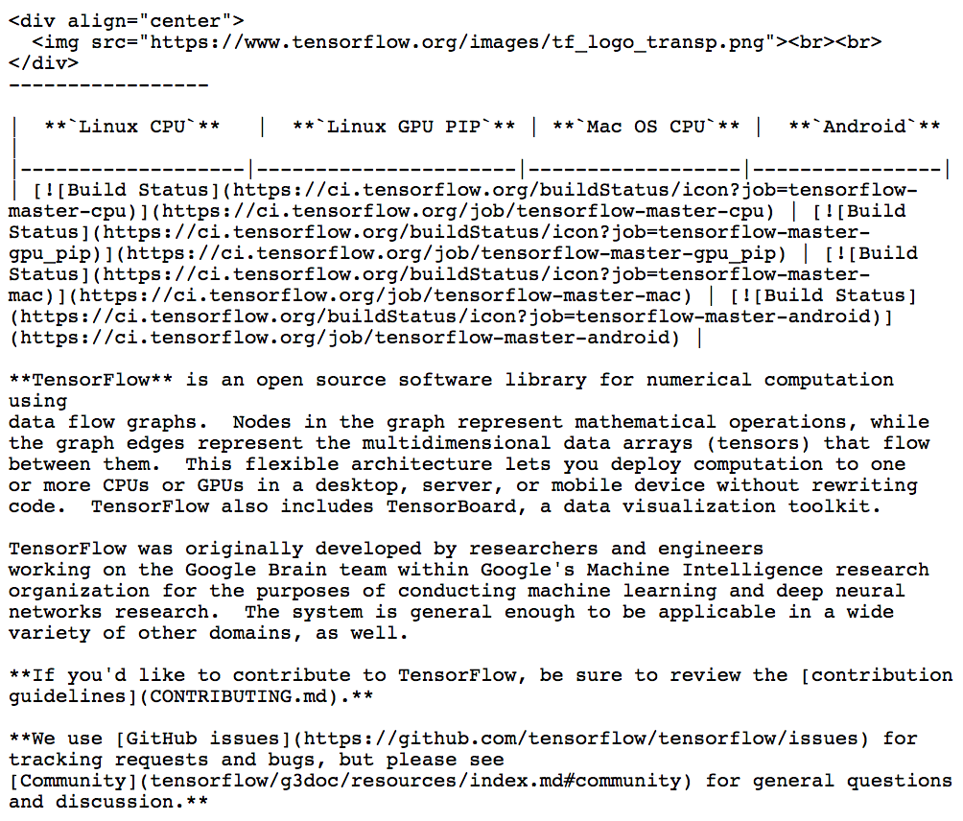
Smart Data
Markdown
2,654 – Repositories
24,010 – Markdown files
99,210 – Python files

Slide 5
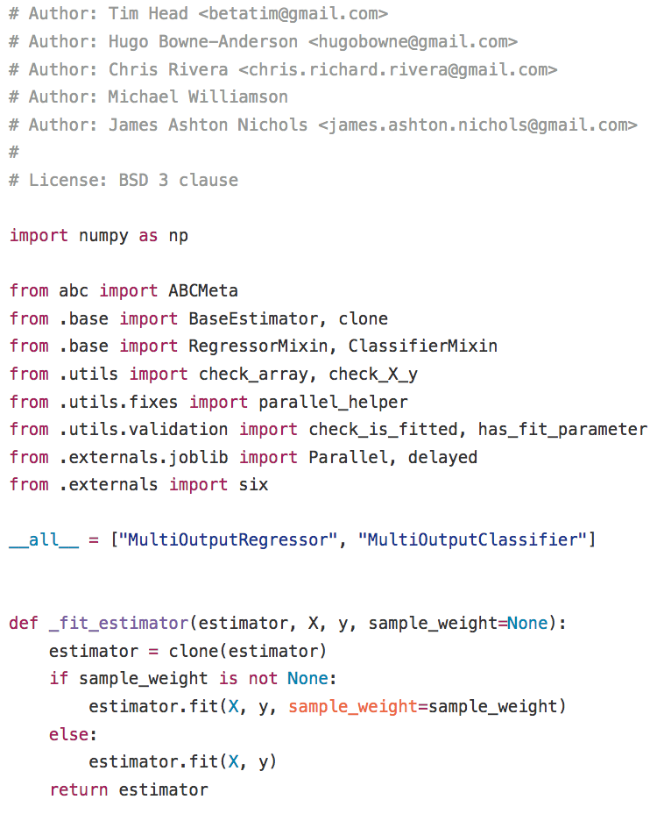
Smart Data
Python
2,654 – Repositories
24,010 – Markdown files
99,210 – Python files

Slide 6
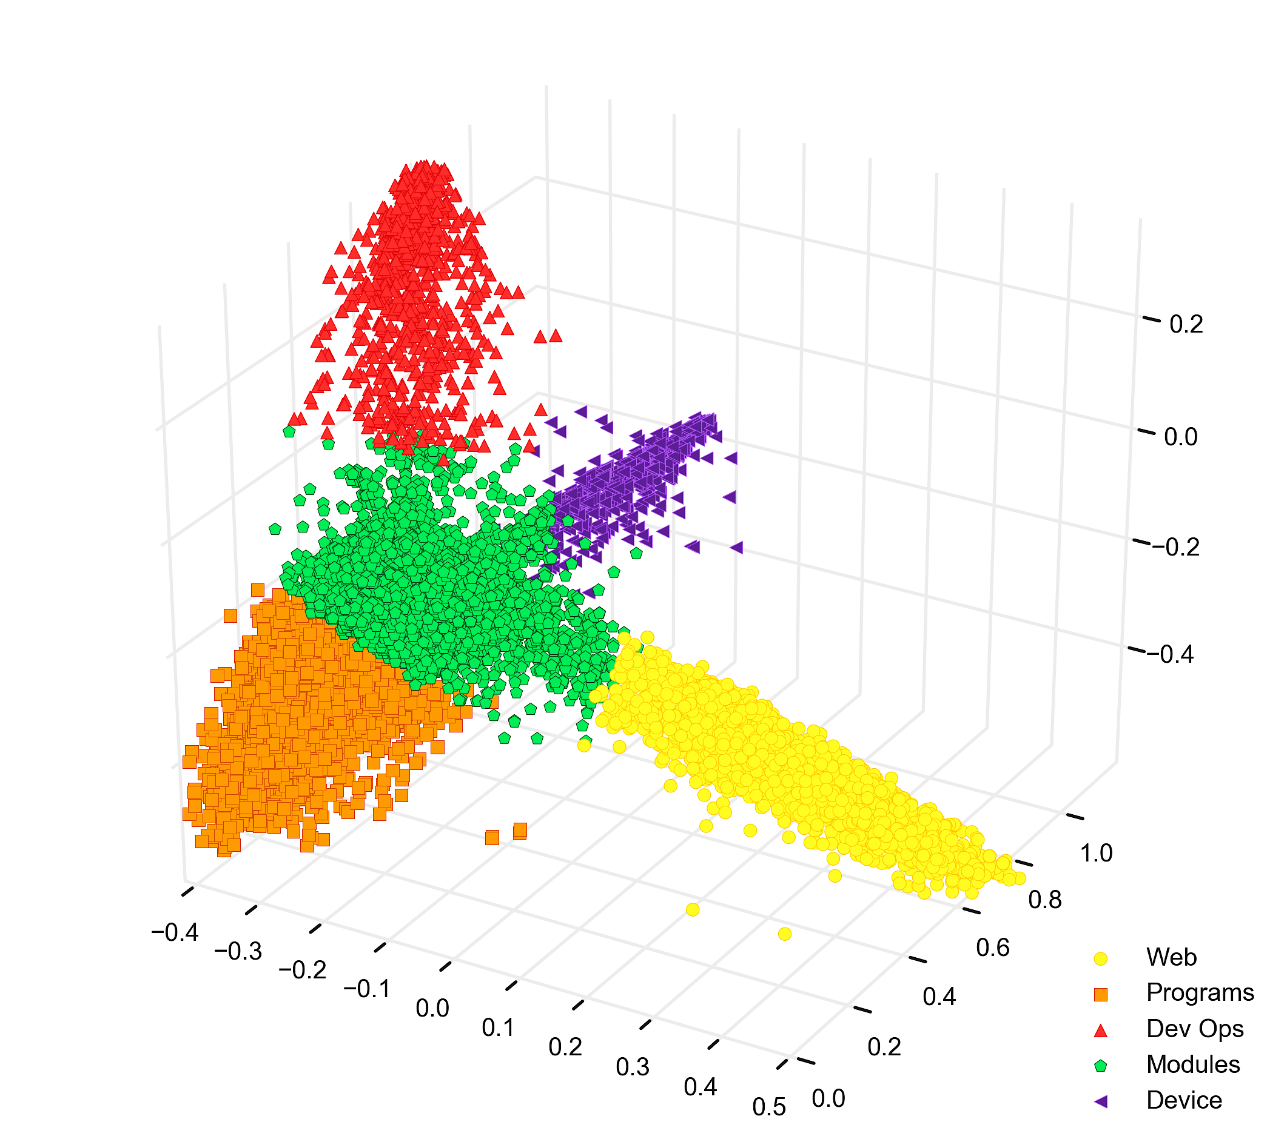

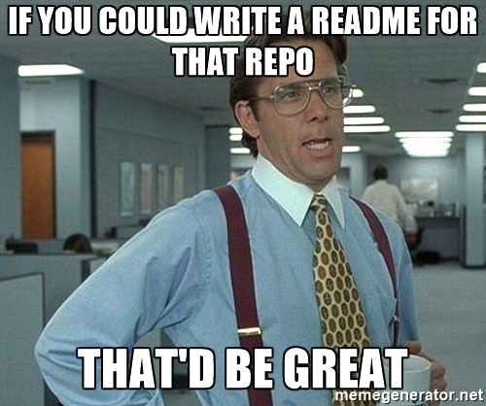
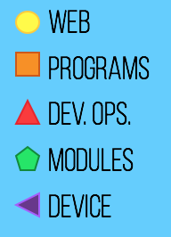
smart CLUSTERS

Slide 7
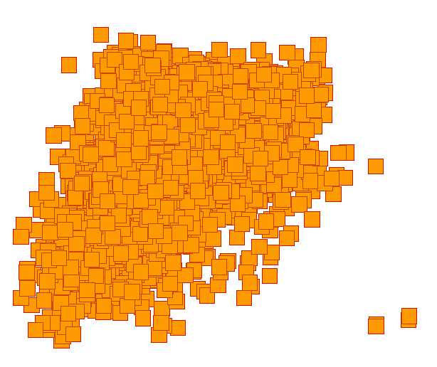
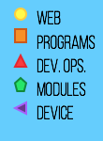
smart CLUSTERS
sklearn
numpy
pandas
matplotlib
nltk
...

Slide 8

smart recommendations
>>> import smartImport as si
>>> si.get_library()
[‘sklearn’, ‘numpy’, ‘pandas’, ‘matplotlib’, ‘nltk’]
>>> import nltk
>>> si.get_coalesce()
[‘re’, ‘string’, ‘textblob’, ‘matplotlib’]

Slide 9

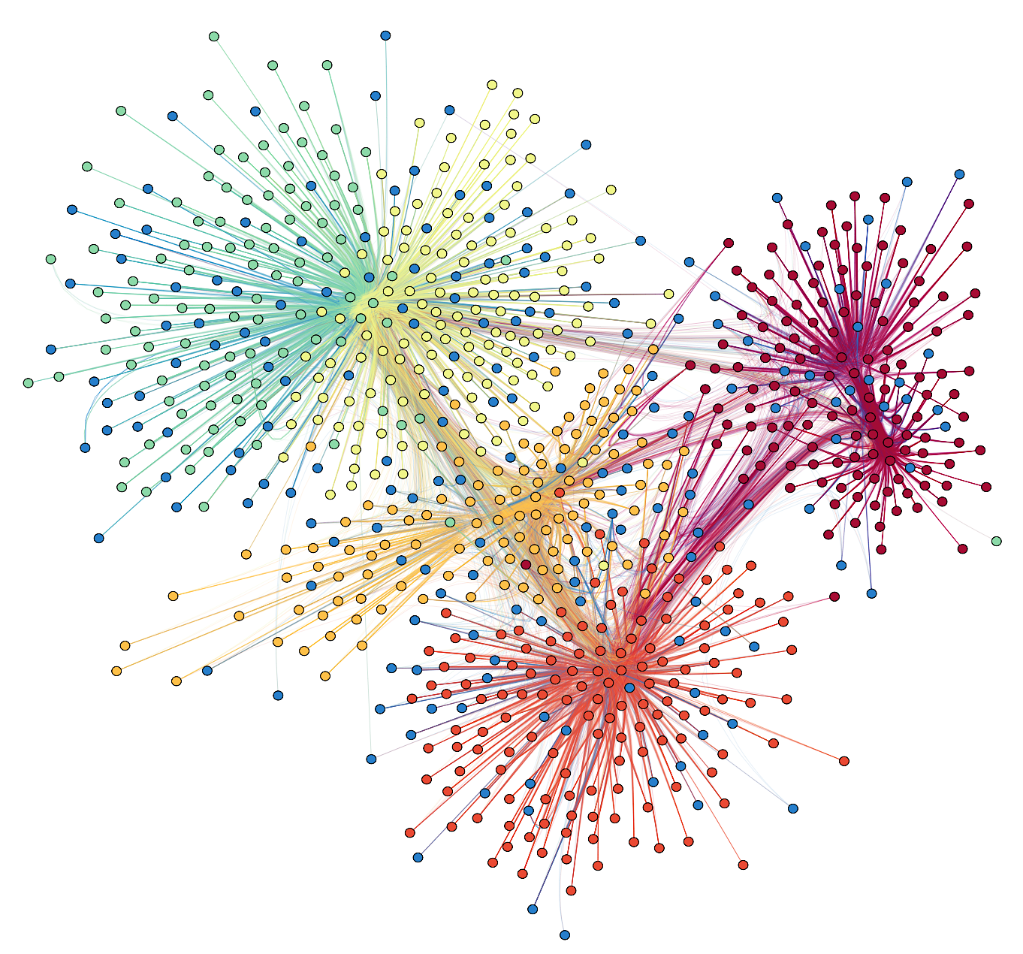
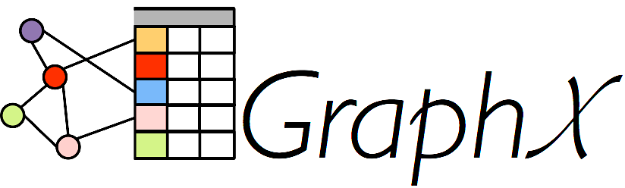
smart future

Slide 10




Thank you!
Bryant Biggs
www.linkedin.com/in/bryantbiggs
github.com/bryantbiggs
medium.com/big-data-engineering

